Slide 1

Working title: CFD and ROM of Flow over a Golf Court
Bachelor project, 2026
Meeting 1, date: 11-03-2026
GROUP 3
Eske Freiesleben
Jacob Manniche
J. Alfred Pedersen
Student ID
S234229
S234258
S230869

Slide 2
Literature so far (1/3)
Literature initially suggested by Søren, before project topic was chosen
Wind-Turbine and Wind-Farm Flows: A Review - Porté-Agel et al., 2019
Take-aways: importance of turbulence, Far- and near wakes and their effects, Time-length scale for different phenomena
Optimizing wind farm control through wake steering using surrogate models based on high-fidelity simulations - Paul Hulsman, Søren Juhl Andersen, and Tuhfe Göçmen, 2020
Take-aways: Surrogate model creation, impact of wakes, very complex so we will come back to it
Predictive and stochastic reduced-order modelling of wind turbine wake dynamics - Søren Juhl Andersen and Juan Pablo Murcia Leon, 2022
Take-aways: PS-ROM methods and creation, First look at POD modes, again very complex so we will come back to it
Bachelor project:
CFD and ROM of Flow over a Golf Court
Notes:
Presenter: Nikolaj

Slide 3
Literature so far (2/3)
Literature initially suggested by Søren, after project topic was chosen
Inflow modelling for wind farm flows in RANS - M. P. van der Laan, M. Baungaard and M. Kelly
Take-aways: Insights for different inflow models and their pros/cons, ABL, RANS
Uncertainty of toggling in wake steering experiments under dinural cycle atmospheric conditions: an LES study - Emily Louise Hodgson, Anton Rohlin Madsen, Frederik Emil Petersen, Tuhfe Göçmen and Søren Juhl Andersen
Take-aways: Effects on wind shear, TI and wind veer during the dinural cycle (day/night transitions) under both convective and stable conditions
From shear to veer: theory, statistics, and practical application - Mark Kelly and Maarten Paul van der Laan, 2023
Take-aways: Importance of shear and veer, formulation of turbulence, eddy diffusion, stability and others.
Again a bit complex, so we will come back to it
Bachelor project:
CFD and ROM of Flow over a Golf Court
Notes:
Presenter: Nikolaj

Slide 4
Literature so far (3/3)
Literature found on our own
Wind data analysis and wind flow simulation over large areas - Angel Terziev et al., University of Sofia, 2014
Take aways: Wind data interpretation, determining surface roughness, Overview of 3D terrain models
Wind Flow Analysis on a Complex Terrain: A reliability study of a CFD tool on forested area including effects of forest module - Görkem Teneler, Master thesis, 2011, Gotland University
Take aways: Describes key parameters for complex terrain modeling, Accounting for trees
Investigation of wind speeds over multiple two-dimensional hills - Paul Carpenter, Nicholas Locke, 1999, Journal of Wind Engineering and Industrial Aerodynamics
Take aways: Effect on wind profile from the impact of different kinds of hills, and hills following hills
Bachelor project:
CFD and ROM of Flow over a Golf Court
Notes:
Presenter: Nikolaj

Slide 5
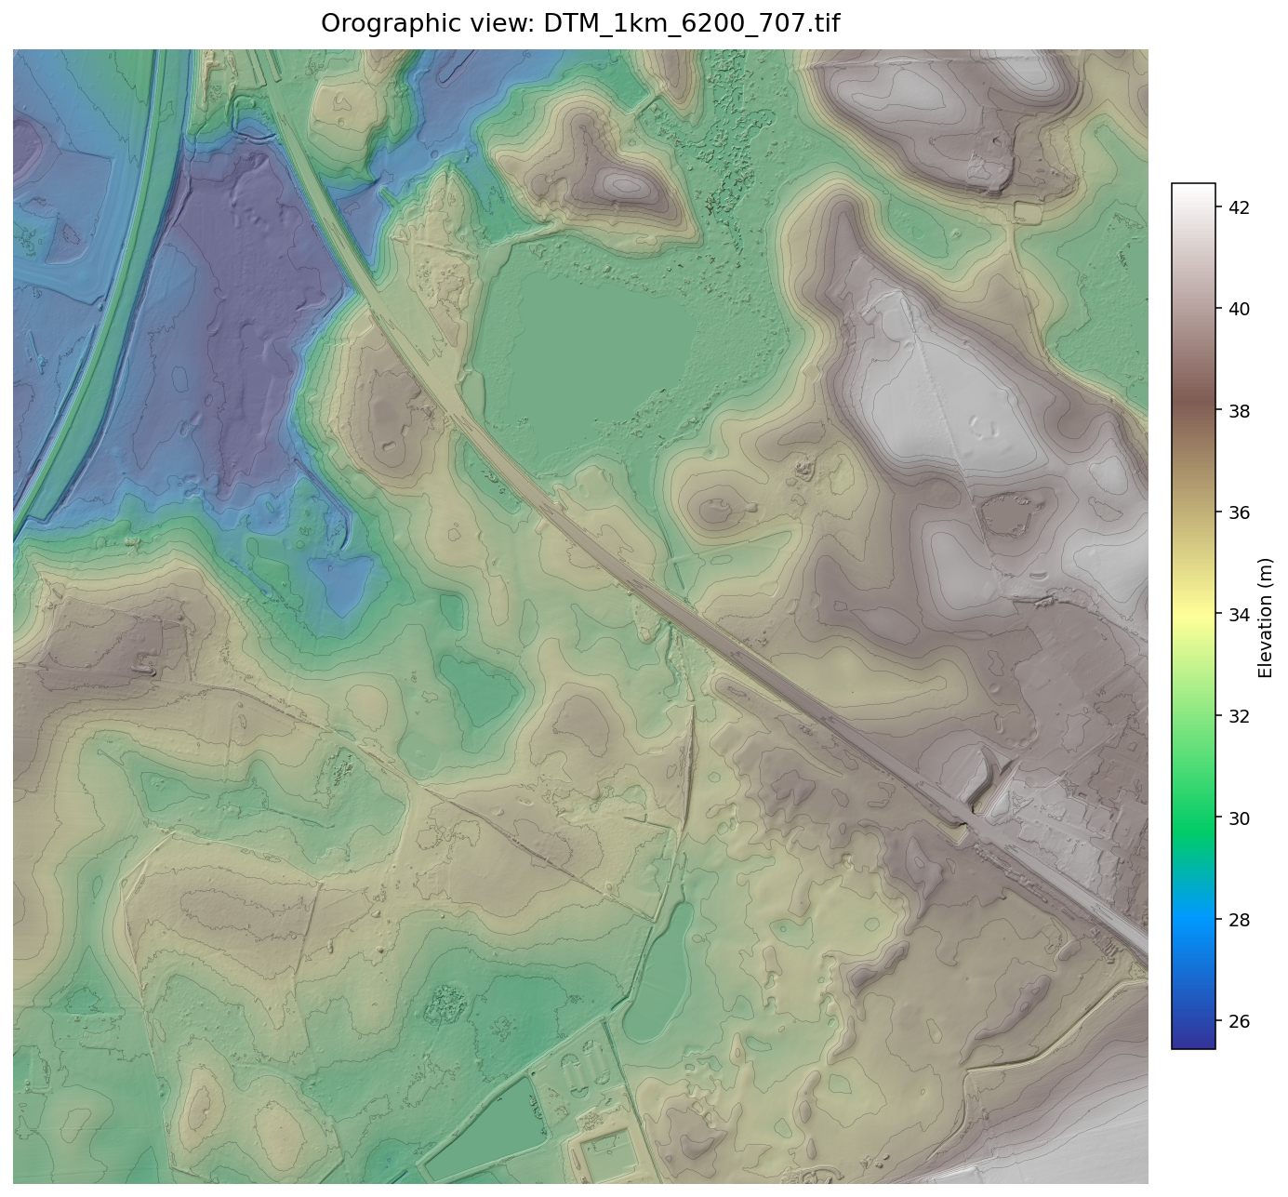
Python warm up
Danmarks Højdemodel - 10x10km data
Downloaded for Hillerød and Hørsholm
Visualized in Python as a height map
Hillerød Golfklub
Bachelor project:
CFD and ROM of Flow over a Golf Court
Notes:
Presenter: Nikolaj

Slide 6
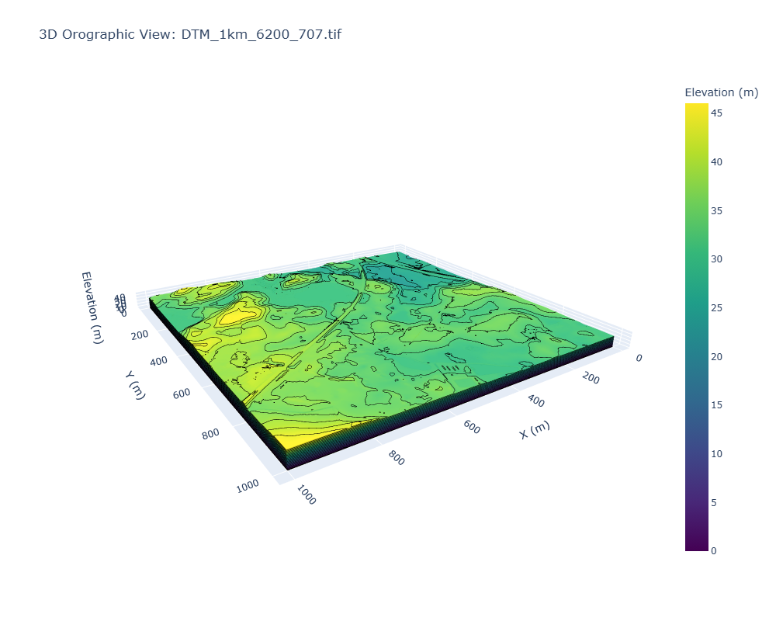
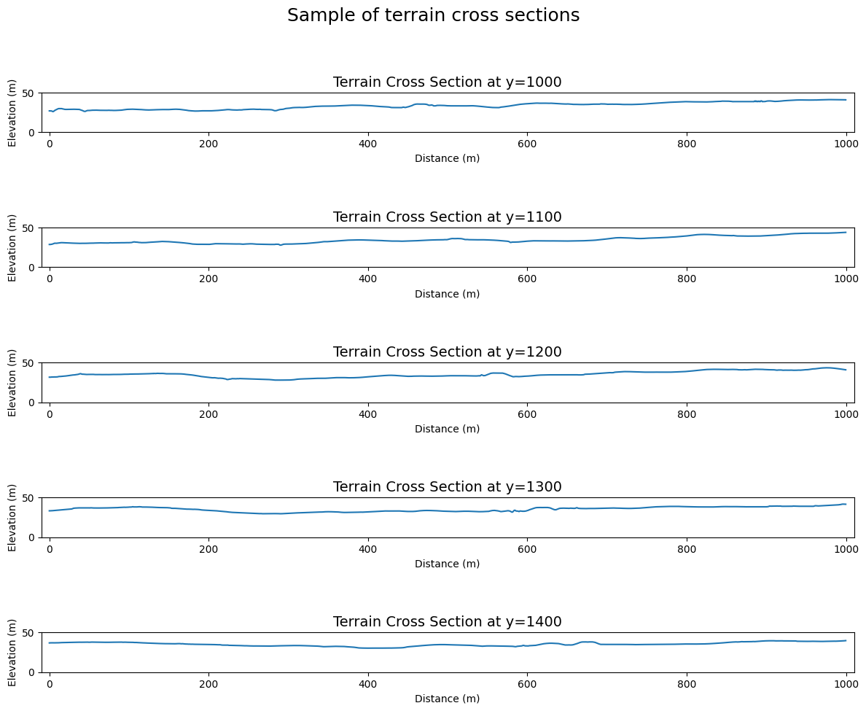
Python warm up
Interactive plot using the plotly package and slicing to get 2D cross sections of terrain
Bachelor project:
CFD and ROM of Flow over a Golf Court
Notes:
Presenter: Nikolaj

Slide 7
Proposal for 3 research questions
How does the wind depend on the surrounding terrain? And how does this effect the aerodynamics of the golf ball?
1.1: Wind interaction and dependencies over flat terrain
Wind shear, veer, TI, temperature, roughness, …
1.2: Wind interaction and dependencies over complex terrain
Look into and understand hills (sinusoidal first, then irregular?) (Speed-up effect (Investigation of wind flow…)
Trees and other structures
How can the wind over a golf court be modelled, what methods are used and how complex is the procedure?
2.1. Modelling wind over golf court
Examining real data?
Bench different models? LES or RANS?
3. How can we model the wind over a golf court
accurately using surrogate model (ROM or ML)?
3.1. Surrogate model for wind over golf court
Create surrogate to model wind flow (ABL model) over golf course or use already created surrogate model to test?
Use created model to further investigate ABL structure
Bachelor project:
CFD and ROM of Flow over a Golf Court
Notes:
Presenter: Nikolaj

Slide 8
Our idea for a structure
1 Introduction
2. Theory
2.1. General Wind theory
Wind speed profile (ABL)
Stability
Temperature impact
Turbulence intensity
Wind veer
Surface roughness
Impact of incline
Impact of Hill(s)
Impact of Trees / structures
2.2. Modelling theory
RANS
LES
ROM (PS-ROM)
3. Data
What data will be used, how is it handled?
DTU in-house tools we need to use?
4. Methods / modelling
Which tools are we using (making a surrogate model / is a surrogate model provided)
5. Results
Benchmarking model against
6. Analysis
7. Discussion
8. Conclusion
Exact structure for these sections
can be determined later
Bachelor project:
CFD and ROM of Flow over a Golf Court
Notes:
Presenter: Nikolaj

Slide 9
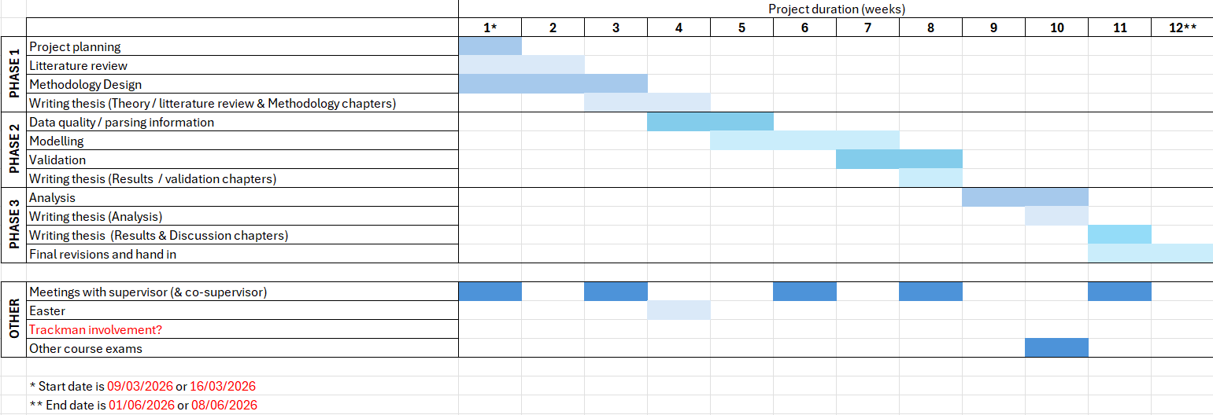
Our idea for a project timeline
Bachelor project:
CFD and ROM of Flow over a Golf Court
Notes:
Presenter: Nikolaj

